Slide 1
Add to Cart

Slide 2
For Add to card functionality we need following main option
Show product
Allow user to add product
When user added there must be a table which is showing detail of shopping like items purchase their quantity and total of those products.
There should be a remove button so user can remove items from table or cart.

Slide 3
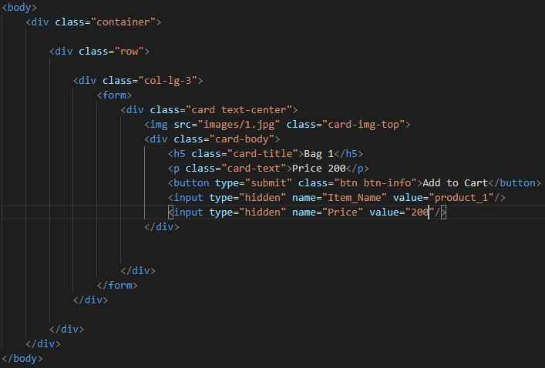
Add files of php in visual studio.
First is index file where all products will be shown and next file mycart will have all items added in cart.
Third will be header file where we make header file and include in our different pages.
Now all three files have been created . I will make header file first with the help of bootstrap.
After creating header file include it in index page and my cart page . Like <?php include("header.php") ?>
Now lets move to edit index page.
I am adding card class from bootstrap and will edit as per requirements.
I have added card class and then put it into form tag because when user click on mycart button some data must be send to mycart page so for this purpose I put whole card into form tag.
Add two hidden input because we want to take Item name and price from index page to mycart page.
These input fields will hold item name and price.
I have removed anchor tag and replace it with button type submit so when user click on it data will be submit to cart page.
Copy same card and change images and other details.

Slide 4
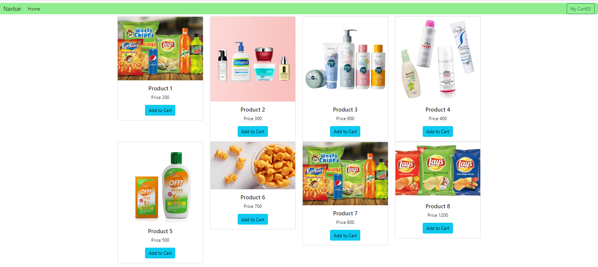
Final look of our home page after adding multiple products.

Slide 5
Now I am adding another page as manage_cart to receive data of all those items who have been clicked by user.
Now go to each form tag we used in index page and add action in form tag. As we said all data from form will be go to manage_cart page add action with url of manage_cart page. Like : action="manage_cart.php“.
As we know that we want item name and price from index page and use them into manage_cart page we need to have method which can store them and then we can call that method on manage_cart page.
So for this purpose I am using post method here.post method is an array which will save values of item name and price and can be access on manage_cart page.so go to each form tag on index page and add method post there.
We want that information when user click on Add to Cart button so for knowing that user has clicked on button or not we have to set name of button so we can check that the button with name of Add_To_Cart has been clicked or not.so go to index page and set name of button Add_To_cart.
After done with index page let’s move toward manage_cart page and do some code of adding items to the cart.

Slide 6
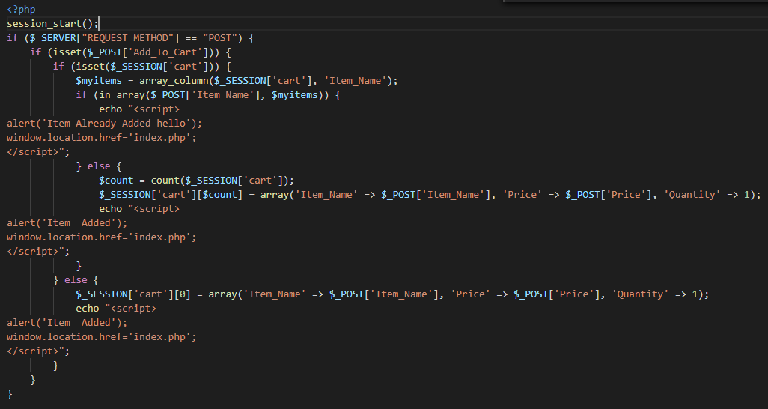

Slide 7
As we are transferring data from one page to another page we need session for that purpose so first of all we will start session as we did in very first line. session_start();
In second line we are checking that coming request is from post method or not. We are doing it because one page can receive many requests like get or post or other, so as we mentioned in our form tag that method will be post ,that is why we are checking it. if ($_SERVER["REQUEST_METHOD"] == "POST")
In third line we are making sure that has user clicked on Add_To_Cart button or not.if user has clicked it then we are checking in next line is there any item already present in cart or not.
If cart session is already set it means cart has already some items.
If cart has already items then we are storing them into $myitems.
Arraycolumn is a builtin function which help us to get all element and store them in to array.we are storing all Item_name into $myitems.
Now we have all items_Name in $myitems.
Now we are using inarray function to search that is clicked item which is coming from post variable is already present in cart or not?
This function takes two parameters ,first the item on which user clicked recently and item we want to sear in array.
Here our new clicked item is coming from post[‘Item_Name’] and our previous item in carts are stored in $myitems so we are passing both.
If condition get true then there will be an alert which will say “Item already added”.and then redirect to index page.

Slide 8
if (isset($_POST['Add_To_Cart'])) {
if (isset($_SESSION['cart'])) {
$myitems = array_column($_SESSION['cart'], 'Item_Name');
if (in_array($_POST['Item_Name'], $myitems)) {
echo "<script>
alert('Item Already Added ');
window.location.href='index.php';
</script>";
}
Now assume that item was not present previously in cart and coming item is new item then if condition will be failed and now we have to add that item into cart.
But before adding we must know the index of array where we can store our new item with already added items.
To know the next index of array we will use count variable to count how may items are already present in session[‘cart’].
After value in count we are just placing information of that item at session[‘cart’] at index number[count].suppose if count returns 5 it means there are 5 items but index is 4 as array start with zero.so we can place our new item at index 5.
After getting index number we are passing an array which contain Item_Name and Price coming from post method from index page and initially we are setting quantity equals to 1.
After adding new item we are showing alert that “item Added”.

Slide 9
else {
$count = count($_SESSION['cart']);
$_SESSION['cart'][$count] = array('Item_Name' => $_POST['Item_Name'], 'Price' => $_POST['Price'], 'Quantity' => 1);
echo "<script>
alert('Item Added');
window.location.href='index.php';
</script>";
}
Now consider the last scenario where user click on button Add to cart and there is no item present in cart previously(cart is empty). Then we don’t need to check about index or items name .we will just simply add that item at index 0 of session[‘cart’]array.
else {
$_SESSION['cart'][0] = array('Item_Name' => $_POST['Item_Name'], 'Price' => $_POST['Price'], 'Quantity' => 1);
echo "<script>
alert('Item Added');
window.location.href='index.php';
</script>";
}
Now check these all conditions once.if you find any abnormality then run session_destroy() method just beneath session_start() on manage_cart page method to empty cart.or clear your brower session.

Slide 10
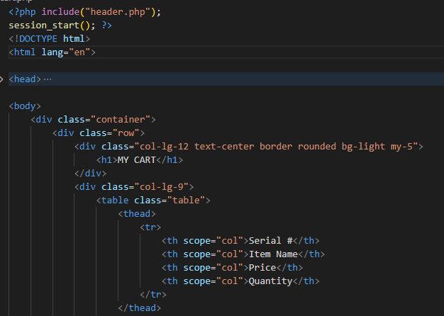
now all itemsave been stored in cart session, so let’s move to mycart page and show all selcted items on table.
the very first thing is to start session so we can get cart items on our mycart page.then add heading of your table which you want to show on my cart page.

Slide 11
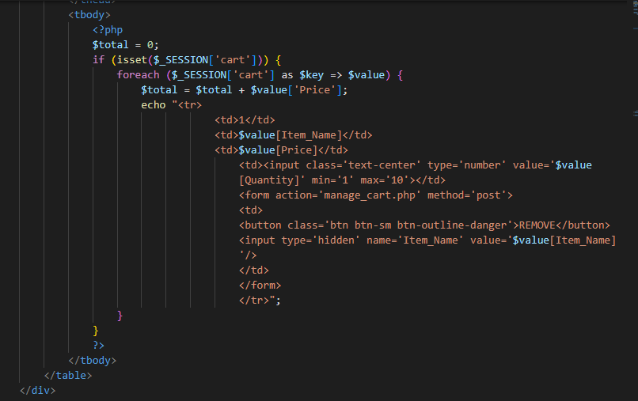
now comes to the table body.
in first if check we are checking if is there any item in cart or not,if there is no item then inner code will not run.but if there is/are item/items in cart then we will use foreach loops to get all items . here session cart => keys means all keys like item name price quantity will save into key and value will receive value aginst each key.
now fetch value of each key and print them in to td by td.
we use number type for quantity to increase or decrease quantity.

Slide 12
after quantity we worked for remove button.
we took a form and set action to manage_cart so when user click on remove button we can take data to manage_cart page where we will do code for removing item from cart.
we have set name for button “Remove_Item” so we can call it by name on manage_cart pge.like if user clicked on button we will check through name.
next we took input type hidden so we can take name of that item which will be remove.method post is used so when we submit form post will hold name of that item which is going to remove.
finally in this ,we have initiallize a total variable so when loop runs each time it will take price of each item present in cart and add them into total variable.
we will use this total variable when we are showing total bill to user.

Slide 13
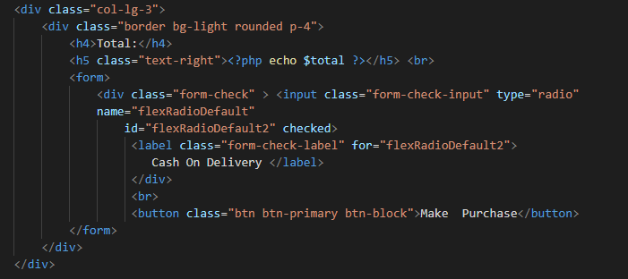
now lets code for total bill view.i have just added some html and css and showing total variable which i declared above on this design.
for now here radio button and make purchase button is just for designing purpose.

Slide 14
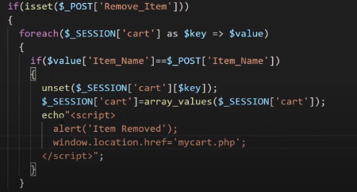
now to remove item move back to manage cart page and do code for it.
We have already check of post method when we were working on add to cart click so within this if condition we are now checking if user click on a button whose name is Remove_Item.if condition true then through loop we are geeting all index of session[cart] array into our $key variable, key variable will hold index number.
Through index we are getting item name into $value variable.now loop will give us item name with index number at this point.
Now we are checking that the item name currently present in value variable is equal to that item which is currently in post[Item_name](coming from mycart.php remove item form).
If both item matched then we will unset the index(present in $key) of that item from $_session_cart variable through unset function.
Now $session_cart array has removed that index what user clicked.but arrangement of array has been disturbed .
For example if array had 6 items and user deleted No 3 index then index No 3 is null which is not good practice. We will rearrange our array each time index deleted from it.
We will rearrange our array through function array_values().
Now finally we are just showing alert that item removed and redirect user to again mycart page.

Slide 15
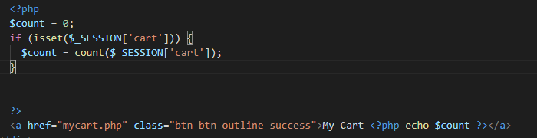
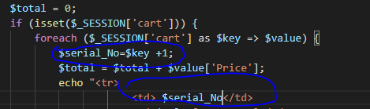
As we noticed after adding items to cart my cart button is still showing 0.it is because we hardcoded (0) in our header file.let’s make it dynamic.
Go to header file and start session there because we want to know how many items have been added to session[cart].
Keep in mind that header file is already used in mycart and index page.if you use session start code there then remove it because included header file will also start session for both of them as we included header file there.
Here we just count indexes of session[cart] and then print them with My cart text.
Now the only issue left is that our mycart page showin 1 at serial No column for every item.lets make it dynamic also.move to mycart page.
As we know key variable is holding index so we will put this key in serial no td so when index change serial no will also change.but indexes starts with 0.and we want to start with 1.
Take a variable and add 1 in key value so when index is zero variable will add 1 to it and so on.

Slide 16
Now our next step is to work with quantity textbox. When user increase or decrease quantity from number input. There should be a column which tell price of individual item as per it’s quantity. Also total which we were showing separately before become grand total and final bill will be shown on that.
To achieve this task move to my cart page and add column total<th> and <td> to our table.in td we will make a class like class=“item_total”,we will use this class to store total of individual item.
As we know total of each item will be come after calculation like quantity* price of single item.so for this we need price and quantity of each item.
For this purpose we will make an input type hidden in td of price so we can take value of price and in that field and can use in further calculation.like
<td>$value[Price]<input type='hidden' class='item_price' value='$value[Price]'</td>
Here first $value[price]is used to show the price of item.then input hidden type value is also $value{price],from this we will take this value into javascript and then multiply it with quantity.
We also make class so we can give reference of this class to hit tag of price .
We also make a class in quantity tag so we can hit that tag from class name and get quantity of item.
Now front end work has been completed now we will add some JavaScript code. We are using javascript here because we are changing in front end directly from browser.javascript will make it easy for us.

Slide 17
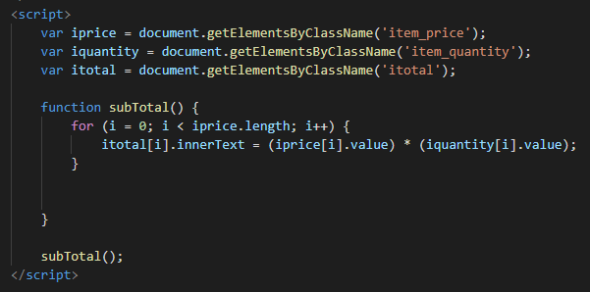
First three lines are used to just access html element.create a function and apply a loop. Remember that our tr is in loop so if items added by users are 4 then tr will also be 4.each element will 4. like price td will also be 4.we have assigned a class to price td which is item_price.it means there will be 4 tags who will have item_price class and same goes for quantity and other tags.
Now in loop we mentioned condition that i< iprice.length , iprice length will be same as number of item present in cart.
In td of total we make a class itotal. Now I want to place total of individual amount through itotal class like:
itotal[i].innerText = (iprice[i].value) * (iquantity[i].value);
Here value of I is zero so first textbox of I price will be considered and it’s value will be multiplied with value of first textbox of quantity.
In same manner loop will be continued .and calculation will be shown in total column through it’s class itotal.
Finally call the function.
Caaling function in script will only run once,but we want to run this function whenever user make changes in quantity input type.
So for doing this we will call function on input type number through onchange built-in function.
<td><input class='text-center item_quantity' type='number' value='$value[Quantity]' onchange='subTotal()' min='1' max='10'></td>

Slide 18
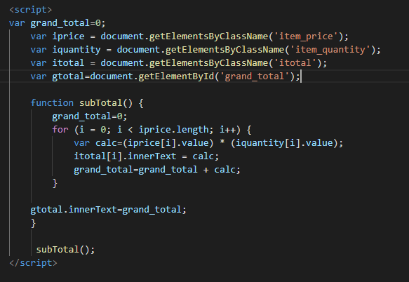
Now individual item total has been calculated .move towards total bill. We have already define total bill through php before but now we don’t need of it because all calculation is done in JavaScript .so we will also calculate total bill through same loop in JavaScript.
So change that total to grand total and remove php from there and just make an id of that html element so we can pass grand total from javascript.
Now in javascript we will take a global variable for grand_total and initialize it as zero;
Also we will define it in function as again make it zero,because we know function will run when any changes occur in quantity.so whenever quantity changes function will start and grand_total variable again become zero to recalculate the grand total.
Now we want in our grand_total variable sum of every individual product as per its quantity will add in grand total variable.
Total of every individual item is in calc variable so we will add gt previous value with calc variable, so all item total will get add in grand_total variable. Like grand_total=grand_total + calc;
Finally just passing calculated grand_total to our id=grand_total.

Slide 19
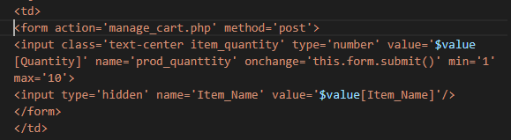
Now check each and every thin is working fine. But have you noticed that when you refresh your page quantity of each page become 1 .this issue is affecting our bill total. The reason of this issue is we have set our quantity by default 1.so when each time page refresh it’s again set to one.
To resolve this issue we need to store our quantity in session[cart].for sending data for quantity box we need to put that quantity box in from with post method so when user increase quantity form will be submitted and quantity will be saved in post variable,after saving in post variable we will assign it to session[cart].
Lets have a practical example of it.mover towards mycart page where quantity box is present and wrap it into from like:
Here I made some changes like wrap td of quantity into form and sending its data to manage_cart page through post method.
I have set name for quantity box so we can use it for fetching value from it.
Onchange function now have this.form.submit() , it means whenever user change quantity of item this form will submitted to manage_Cart page where we will code for quantity updation.
Remember that we also need to know that which item quantity is increasing or decreasing so we also need item name here.so I take item name as hidden field ,through this we can match our item name whose quantity is changing with those items who are present in cart.once it will match quantity will also be saved in cart.

Slide 20
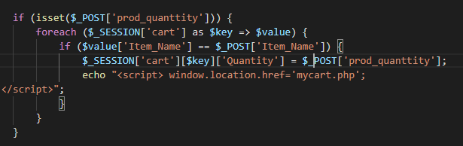
Now move towards manage_cart page where we code for changing quantity.
In first if we are checking that is quantity changed.if it is changed then post method must have some value.if it contains value then we are running loop to find out which item quantity is changed by user.
When item name present in cart will match with item name coming from post method then we will set quantity .
In second if we are entering in session[cart] and through key we are going in quantity value,then we are replacing that quantity with quantity which is present in post method quantity(coming from form).

Slide 21
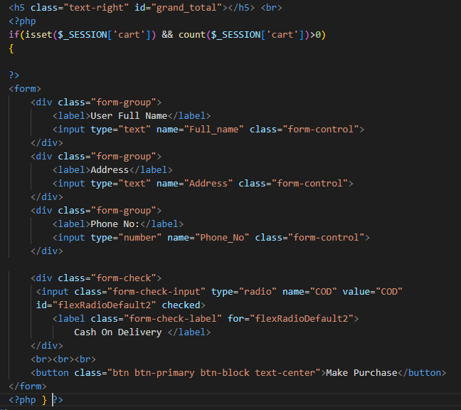
Now at this point each and every thing in our cart is working perfectly. Our last task is to dump this order into database with some customer information so for this we are making a form where we will take user information and then save it with order details.
So firstly we will add from and make it visible only when user have some item/items in cart.so move towards mycart page and do some code for front end.
Here we have made a form where user enter his name address and phone number.
As we are going to store shopping info in database so this form is only visible when user have something in cart.
we are checking two checks here first if cart session is started or not, if session has started then we are checking that is that session has some items or not if items are greater than 0 then user will have our info form.
We are checking count in cart because it is possible that user have selected some items ,due to that session was started but after some time user removed all items then cart is empty, and with empty cart we are not intended to store values in db.

